Slide 1

Understanding Real-Time Systems: Design and Analysis
Based on the book by Phillip A. Laplante & Seppo J. Ovaska
Navarro, Rod Geryk C.
CPE161P-4– C1

Slide 2

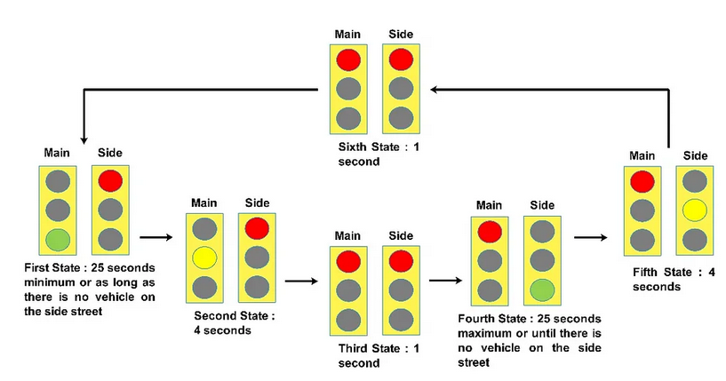
What Are Real-Time Systems?
Chapter 1: Fundamentals of Real-Time Systems
Real-time systems process information and provide responses within a specific time limit.
Examples: Airbag systems, medical devices, autopilot systems in planes.
Figure 1. A traffic light control system with strict timing requirements.
Ref: https://medium.com/dialog-semiconductor/traffic-signal-controller-bf921278809d

Slide 3
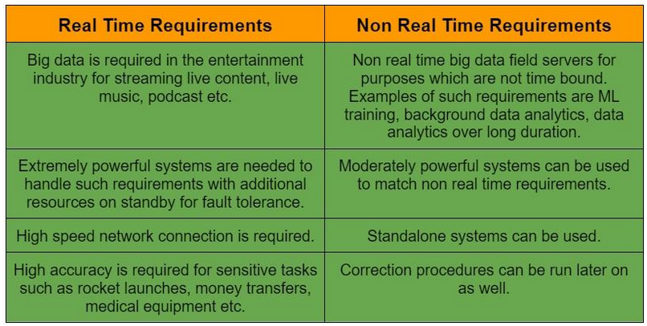
Common Misconceptions
Misconception 1: Real-time means "fast." (Not always; it means predictable timing.)
Misconception 2: All embedded systems are real-time. (Not necessarily.)
Figure 2. A comparison of a real-time and a non-real-time system.
Ref: https://www.naukri.com/code360/library/real-time-and-non-real-time-requirements

Slide 4
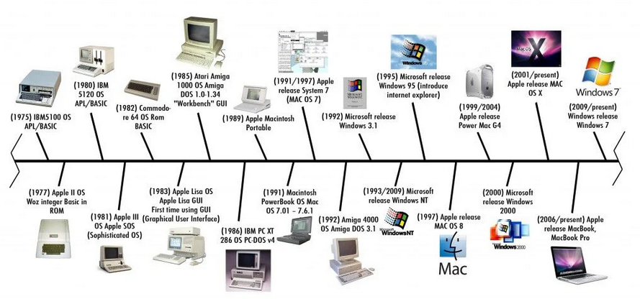
Evolution of Real-Time Systems
Figure 3. A timeline showing major advancements in real-time computing.
Ref: https://softwareg.com.au/blogs/computer-hardware/history-of-computer-hardware-timeline
From simple mechanical timers to modern AI-driven control systems.
Growth in applications: robotics, medical devices, and industrial automation.

Slide 5
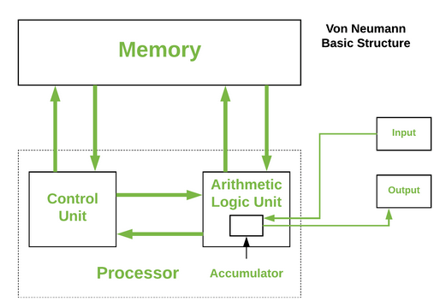
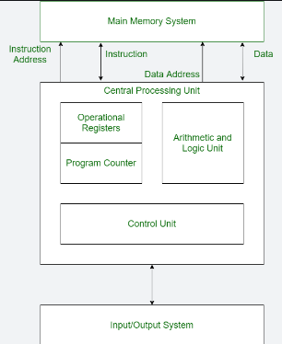
Basics of Processor Architecture
Chapter 2: Hardware for Real-Time Systems
Figure 4. Von Neumann Architecture
Ref: https://www.geeksforgeeks.org/computer-organization-von-neumann-architecture/
Figure 5. Harvard Architecture
Ref: https://www.geeksforgeeks.org/harvard-architecture/
Von Neumann Architecture: Single memory for instructions and data.
Harvard Architecture: Separate memory for instructions and data (faster).

Slide 6
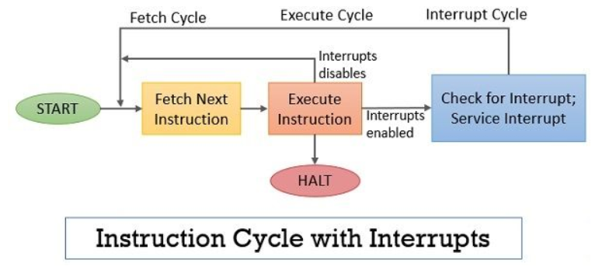
Instruction Processing & I/O Considerations
CPU processes instructions in steps: Fetch → Decode → Execute.
Interrupts: How CPUs handle urgent tasks efficiently.
Figure 6. Flowchart of instruction execution cycle with Interrupts.
Ref: https://binaryterms.com/instruction-cycle.html

Slide 7
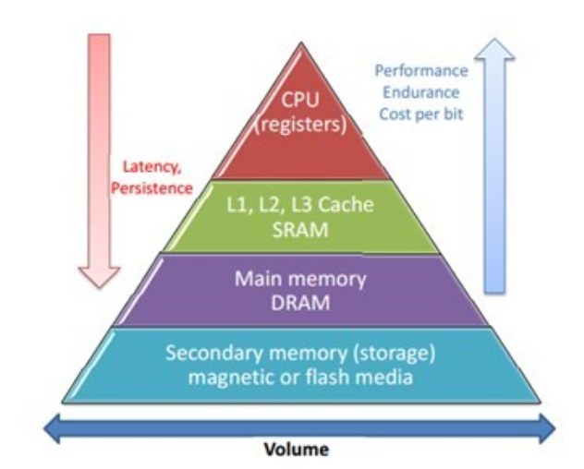
Memory Organization in Real-Time Systems
RAM (volatile) vs. ROM (non-volatile).
Cache Memory: Faster access for commonly used data.
Hierarchical memory: Helps balance speed and cost.
Figure 7. A pyramid showing different memory types.
Ref: https://www.researchgate.net/figure/The-memory-hierarchy-pyramid_fig1_319529366

Slide 8
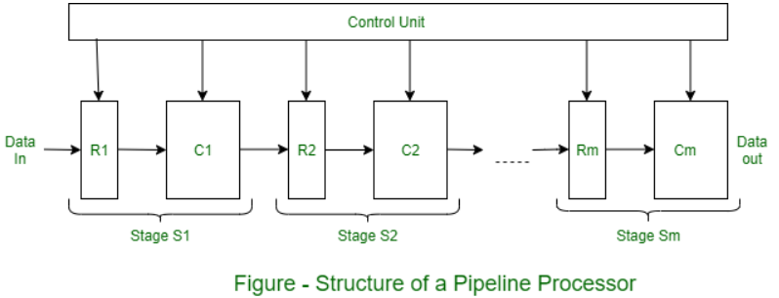
Multi-Core Processors & Pipelining
Multi-core CPUs process tasks in parallel, increasing efficiency.
Pipelining: Breaking tasks into smaller steps to work on them simultaneously.
Figure 8. A pipeline processing diagram.
Ref: https://www.geeksforgeeks.org/pipelined-architecture-with-its-diagram/

Slide 9
Microprocessors vs. Microcontrollers
Microprocessor: General-purpose CPU (used in computers).
Microcontroller: Includes CPU, memory, and I/O (used in embedded systems)

Slide 10
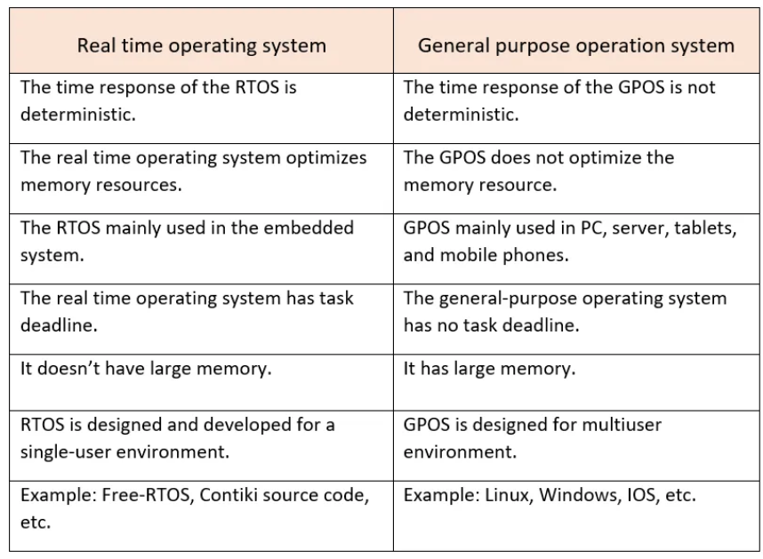
What is an RTOS?
Chapter 3: Real-Time Operating Systems (RTOS)
Special software that manages tasks with strict timing rules.
Examples: FreeRTOS, VxWorks, QNX.
Figure 9. Comparison of general OS vs. RTOS task scheduling.
Ref: https://www.investopedia.com/terms/g/gantt-chart.asp
Figure 9. Comparison of general OS vs. RTOS task scheduling.
Ref: https://medium.com/@aditya.bonte20/difference-between-rtos-and-gpos-11d1990044ec

Slide 11
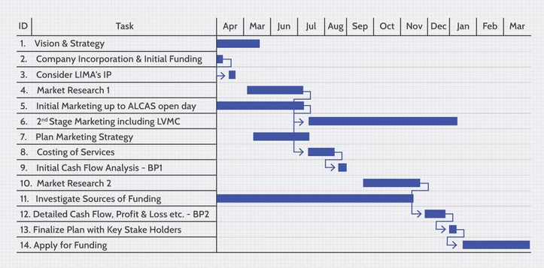
Task Scheduling in RTOS
Figure 10. Comparison of general OS vs. RTOS task scheduling.
Ref: https://www.investopedia.com/terms/g/gantt-chart.asp
Round-robin scheduling: Equal time for each task.
Priority scheduling: Higher-priority tasks execute first.
Image: Gantt chart showing different scheduling strategies.

Slide 12
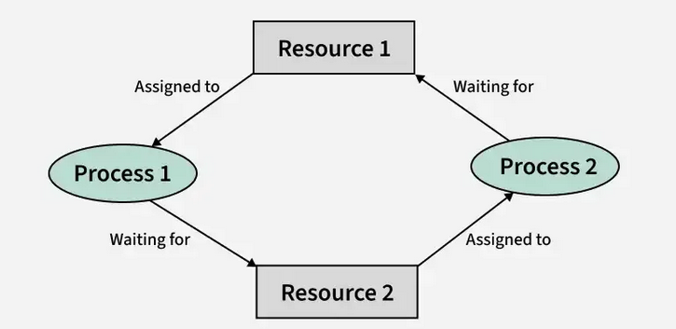
Synchronization and DeadlocksSemaphores: Prevent two tasks from using the same
Semaphores: Prevent two tasks from using the same resource at the same time.
Deadlock: Two tasks waiting for each other to finish (causing a system freeze).
Figure 12. A diagram of two processes stuck in a deadlock.
Ref: https://www.geeksforgeeks.org/introduction-of-deadlock-in-operating-system/

Slide 13
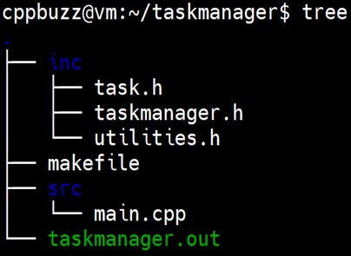
Choosing a Language for Real-Time Software
Chapter 4: Programming Languages for Real-Time Systems
Ada: Designed specifically for real-time safety-critical applications.
C and C++: Most used for embedded systems.
Figure 13. Code snippet showing real-time task management in C
Ref: https://www.cppbuzz.com/c++/projects/c++-mini-project-on-task-manager-with-source-code

Slide 14
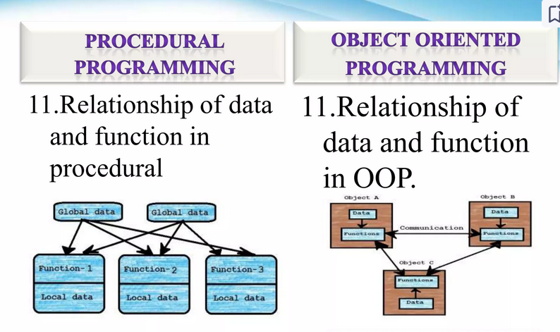
Object-Oriented vs. Procedural Programming
Procedural: Direct and simple (C, Assembly).
Object-Oriented: Reusable and modular (C++, Java).
Figure 14. A side-by-side comparison of an OOP class vs. procedural function.
Ref: https://www.slideshare.net/abhishekkmr_92/ak-procedural-vs-oop#8

Slide 15
Writing Effective System Requirements
Chapter 5: Requirements Engineering for Real-Time Systems
Clearly Define System Requirements:
Articulate what the system must do to meet user needs.
Ensure requirements are specific, measurable, attainable, relevant, and time-bound (SMART).
Provide Specific Examples:
Example: "The system must respond within 2ms."
Use clear, concise language to avoid ambiguity.
Use Structured Requirement Document Format:
Implement a standardized format for requirement documentation.
Ensure consistency and clarity across all system requirements.
Incorporate Visuals for Clarity:
Example: Include images of a structured requirement document format.
Use diagrams and flowcharts to enhance understanding.
Review and Validate Requirements:
Conduct reviews with stakeholders to ensure requirements are accurate and complete.
Validate requirements through prototyping or simulation if possible.
Ensure Traceability:
Maintain traceability of requirements throughout the project lifecycle.
Link requirements to their corresponding design, implementation, and testing stages.

Slide 16
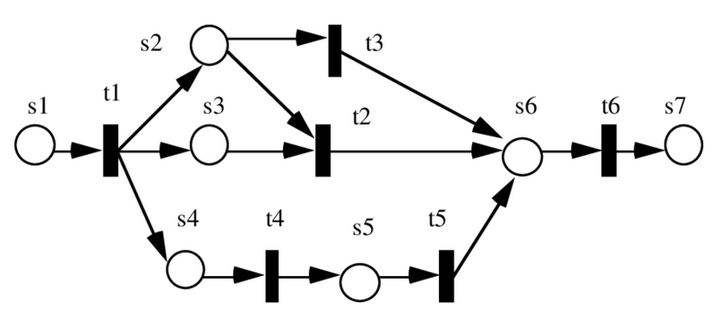
Formal and Semiformal Specification Methods
Statecharts: Graphical representation of system states.
Petri Nets: Used for modeling concurrent processes.
Figure 15. A sample Petri Net diagram.
Ref: https://www.researchgate.net/figure/An-Example-of-Petri-Nets-Graph_fig4_228713375

Slide 17
Object-Oriented Design in Real-Time Systems
Chapter 6: Software Design Approaches
Benefits: Modularity, reusability, and scalability.
Design patterns: Common solutions for recurring problems.
Benefits of Design Patterns
Flexibility:
Design patterns allow systems to adapt to changes with minimal impact.
This flexibility supports the evolution of systems as new requirements emerge.
Cost-Effectiveness:
By reusing established patterns, development and maintenance costs are reduced.
Efficient solutions lower the need for extensive rework, saving time and resources.

Slide 18
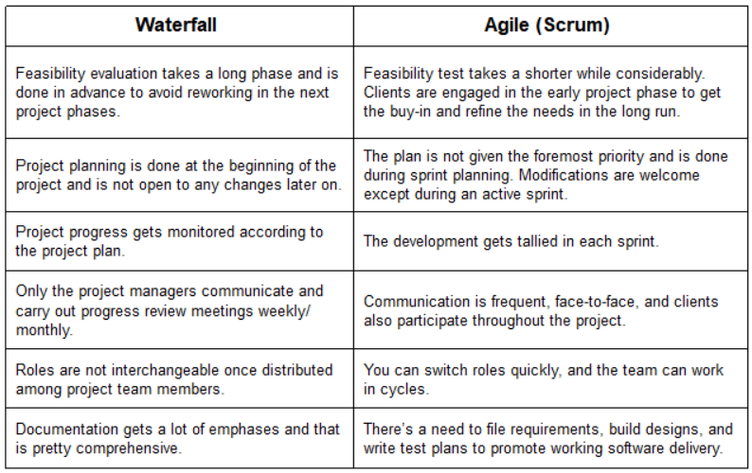
Life Cycle Models for Real-Time Software
Agile Model: Iterative, allows for flexibility.
Waterfall Model: Step-by-step, rigid process.
Figure 16. Waterfall vs. Agile model comparison.
Ref: https://www.edrawsoft.com/agile-vs-waterfall.html

Slide 19
Networking in Real-Time Systems
Chapter 7: Real-Time Communication Systems
Networking Technologies in Real-Time Systems
Wired Networks:
Examples: Ethernet, CAN bus.
Provide reliable and high-speed data transmission.
Commonly used in environments where stability and low latency are critical.
Wireless Networks:
Examples: Wi-Fi, Zigbee.
Offer flexibility and ease of installation.
Suitable for applications requiring mobility and remote access.
Industrial Communication Protocols
Fieldbus Networks:
Used for industrial automation communication.
Facilitate real-time data exchange between control systems and devices.
Real-Time Network Protocols:
Designed to meet the stringent timing requirements of real-time systems.
Ensure timely and deterministic communication for critical applications.

Slide 20
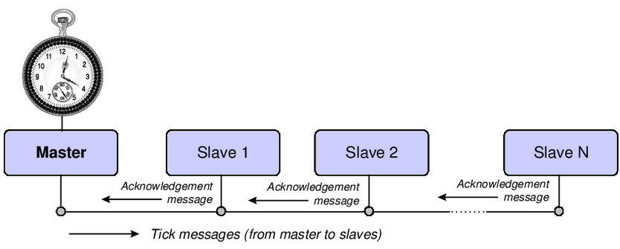
Time-Triggered Communication
Figure 17. A time-triggered message scheduling chart.
Ref: https://www.researchgate.net/figure/Simple-architecture-of-time-triggered-shared-clock-scheduler_fig1_308611848
Ensures messages are sent at fixed intervals.
Used in automotive and aerospace systems.

Slide 21
Measuring Real-Time Performance
Chapter 8: Performance Analysis and Optimization
Key Performance Metrics in Real-Time Systems
Response Time:
Measures how quickly a system can respond to an input or event.
Critical for applications where delays can lead to failure or safety risks.
Jitter:
Represents the variability in response time.
Minimizing jitter is essential to maintain consistent performance in real-time systems.
Deadline Miss Rate:
Indicates the frequency of missed deadlines.
A lower deadline miss rate is crucial for ensuring the reliability of time-critical applications.
Example Application
Airbag Deployment System:
Requires extremely low response time to deploy airbags in milliseconds during a collision.
Response time analysis ensures the system meets stringent safety standards.
Minimized jitter and low deadline miss rate are vital to guarantee timely airbag deployment in every scenario.

Slide 22
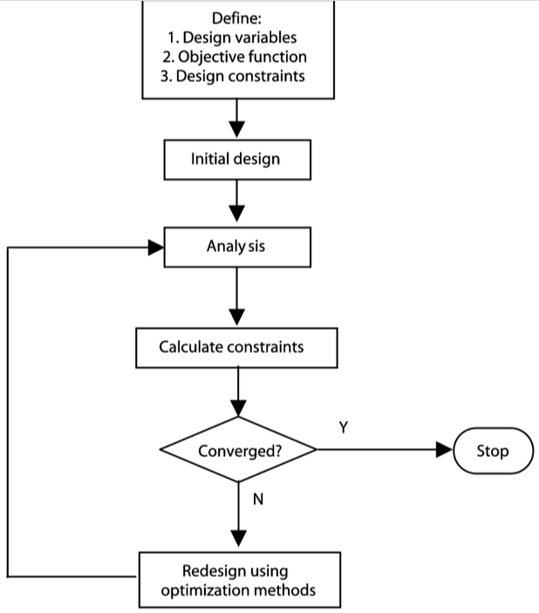
Optimization Strategies
Code optimization: Reducing execution time.
Hardware acceleration: Using GPUs or FPGAs.
Figure 18. Flowchart of an optimized system process.
Ref: https://www.researchgate.net/figure/Flow-chart-of-the-optimization-procedure_fig1_246044375

Slide 23
Safety-Critical Systems
Chapter 9: Safety and Security in Real-Time Systems
Examples of Critical Real-Time Systems
Medical Devices:
Examples: Pacemakers, insulin pumps, and ventilators.
Require precise timing and reliability to ensure patient safety.
Nuclear Reactors:
Control and safety systems monitor and manage reactor operations.
Timely responses are crucial to prevent accidents and ensure safe operation.
Fail-Safe Mechanisms
Redundant Backup Systems:
Implement multiple layers of redundancy to handle failures.
Ensure that a backup system can take over seamlessly if the primary system fails.
Watchdog Timers:
Continuously monitor system performance.
Trigger corrective actions if the system becomes unresponsive or fails.

Slide 24
Cybersecurity in Real-Time Systems
Security in Real-Time Systems
Threats:
Hacking:
Unauthorized access to systems, potentially leading to data breaches and control overrides.
Malware:
Malicious software designed to disrupt, damage, or gain unauthorized access to systems.
Data Corruption:
Unintended alterations to data that can compromise system integrity and functionality.
Solutions:
Encryption:
Protects data by converting it into a coded format, making it inaccessible to unauthorized users.
Firewalls:
Act as barriers to prevent unauthorized access to or from private networks.
Access Controls:
Restrict user access to systems and data based on predefined permissions and roles.
Regular Updates and Patches:
Keep systems up to date with the latest security measures and fixes for known vulnerabilities.

Slide 25
Future of Real-Time Systems
Advanced Technologies in Real-Time Systems
AI-Powered Real-Time Decision-Making:
Utilizes machine learning algorithms to analyze data and make decisions instantly.
Enhances efficiency and accuracy in applications like autonomous vehicles and predictive maintenance.
Quantum Computing for Real-Time Processing:
Explores the use of quantum mechanics to perform computations at unprecedented speeds.
Potentially revolutionizes real-time processing capabilities, enabling solutions to complex problems beyond the reach of classical computing.

Slide 26
Conclusion & Final Thoughts
Real-time systems have become indispensable in the landscape of modern technology, underpinning a wide range of applications that demand precise timing and immediate responsiveness. These systems are designed to perform tasks within strict time constraints, ensuring that operations are executed in a timely manner to achieve desired outcomes. From managing critical functions in healthcare devices, such as pacemakers and ventilators, to controlling industrial automation processes in manufacturing plants, real-time systems play a pivotal role in maintaining the safety, efficiency, and reliability of various technological ecosystems.

Slide 27
Before you go….. Let’s test your knowledge

Slide 28
Fundamentals of Real-Time Systems
1. What is the defining characteristic of a real-time system? A) High processing power B) Execution of tasks in any order C) Guaranteed response within a specific time D) Use of advanced programming languages
2.Which of the following is an example of a hard real-time system? A) Video streaming application B) Online shopping website C) Anti-lock braking system (ABS) in cars D) Cloud-based database
3.Which of the following is NOT a real-time system scheduling approach? A) Rate-Monotonic Scheduling (RMS) B) Earliest Deadline First (EDF) C) Round-robin scheduling D) Pipelining
4.n real-time systems, latency refers to: A) The time required to execute all tasks B) The delay between task initiation and completion C) The total system execution time D) The number of completed tasks per second
Hardware for Real-Time Systems
5.What is the main advantage of the Harvard architecture over the Von Neumann architecture? A) Uses separate memory for instructions and data B) Requires less hardware C) Has faster data processing in general-purpose computing D) Reduces power consumption significantly
6.Which of the following memory types provides the fastest access speed? A) RAM B) Hard disk C) Cache memory D) Flash storage
7.Which type of processor is typically used in real-time embedded systems? A) General-purpose CPU B) Digital Signal Processor (DSP) C) Quantum Processor D) Graphics Processing Unit (GPU)
Real-Time Operating Systems (RTOS)
8.What is the main role of an RTOS (Real-Time Operating System)? A) To optimize memory usage B) To manage hardware components efficiently C) To schedule tasks with strict timing constraints D) To improve system security
9.What happens in a priority inversion scenario? A) A lower-priority task prevents a higher-priority task from executing B) The system reboots unexpectedly C) The highest-priority task executes first D) The CPU enters an idle state
10.Which of the following real-time scheduling algorithms dynamically assigns priorities
based on task deadlines? A) Rate-Monotonic Scheduling (RMS) B) First-Come-First-Serve (FCFS) C) Earliest Deadline First (EDF) D) Round-robin

Slide 29
11.Which of these programming languages is commonly used in real-time systems? A) Python B) Ada C) JavaScript D) SQL
12.Why is garbage collection generally avoided in real-time systems? A) It increases CPU efficiency B) It can cause unpredictable delays C) It improves memory utilization D) It reduces power consumption
Real-Time System Design and Engineering
13.In real-time system development, Worst-Case Execution Time (WCET) refers to: A) The average execution time of a task B) The shortest execution time of a task C) The maximum time required for a task to complete D) The total time for all tasks in the system
14.Which method is commonly used to model real-time systems and their state
transitions? A) Entity-Relationship Diagrams (ERD) B) Unified Modeling Language (UML) C) Finite State Machines (FSM) D) Relational Databases
15.What is the primary goal of real-time system performance analysis? A) Reducing power consumption B) Ensuring that all tasks meet their deadlines C) Increasing execution speed D) Eliminating system logs
Real-Time Scheduling and Synchronization
16.What is the main disadvantage of Rate-Monotonic Scheduling (RMS)?
A) It does not support preemptive multitasking B) It is only effective for dynamic task priorities C) It cannot guarantee schedulability if CPU utilization exceeds a certain limit D) It can only schedule one task at a time
17.What is the purpose of a semaphore in real-time systems? A) Prevent deadlocks B) Synchronize concurrent tasks C) Allocate memory efficiently D) Handle interrupts
18.What is the key advantage of Earliest Deadline First (EDF) scheduling? A) Simple to implement B) Maximizes CPU utilization by prioritizing tasks with the nearest deadline C) Does not require task priority levels D) Ensures 100% predictability of execution
Real-Time System Case Studies
19.A pacemaker that regulates heartbeats is an example of a: A) Hard real-time system B) Soft real-time system C) Best-effort system D) Cloud-based system
20. In an automated car braking system, what happens if a real-time deadline is missed? A) The system continues operating normally B) The car will gradually slow down C) The system fails, causing potential accidents D) The system restarts automatically

Slide 30
Thank you
Answer Key:
C) Guaranteed response within a specific time
C) Anti-lock braking system (ABS) in cars
D) Pipelining
B) The delay between task initiation and completion
A) Uses separate memory for instructions and data
C) Cache memory
B) Digital Signal Processor (DSP)
C) To schedule tasks with strict timing constraints
A) A lower-priority task prevents a higher-priority task from executing
C) Earliest Deadline First (EDF)
B) Ada
B) It can cause unpredictable delays
C) The maximum time required for a task to complete
C) Finite State Machines (FSM)
B) Ensuring that all tasks meet their deadlines
C) It cannot guarantee schedulability if CPU utilization exceeds a certain limit
B) Synchronize concurrent tasks
B) Maximizes CPU utilization by prioritizing tasks with the nearest deadline
A) Hard real-time system
C) The system fails, causing potential accidents

